Slide 1
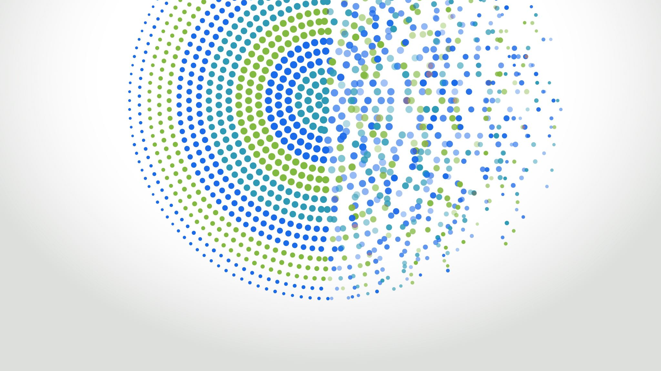
From Theory to Practice: Pfizer's Medicense Usecase
Using Pfizer's real-world example...

Slide 2

Feeding the Beast: How to Train Your LLM?
Discuss various options to add new data to an LLM...

Slide 3

Cracking the Code: Unveiling the Magic Behind RAG
Dive into the fascinating concept of Retrieval-augmented generation...

Slide 4

How RAG Thinks: A Peek Into Vectors
Understand how RAG uses vectors...

Slide 5

Preparation is Key: Ingesting Documents for LLMs
Learn the essential steps to prepare a document...

Slide 6

Talking to the Oracle: How to Ask Questions to LLM?
Unveil the process of crafting effective questions...

Slide 7

Prompting the Future: Example of a Question Prompt
Analyze an example of a well-structured question prompt...

Slide 8

See it to Believe it: Demo of Ingestion and Q&A
Walkthrough of a real-world demonstration...

Slide 9

Painting the Big Picture: The Azure Cloud Services Diagram
Visualize the complete process...

Slide 10

Tying it All Together: The Grand Finale
Summarize the key takeaways from the session...

Slide 11

Open Mic: Q&A Session
Invite the audience to ask their burning questions...

